Slide 1
AWS S3 Cross Region Replication
Presented By KV Prem Kumar

Slide 2
Amazon S3 Cross-Region Replication (CRR):
CRR stands for Cross-Region Replication. It is a feature in Amazon S3 (Simple Storage Service) that allows you to automatically replicate your data from one AWS region to another.
In simple terms, CRR ensures that the files (or objects) you store in an S3 bucket in one region are copied to another S3 bucket in a different region. This helps with data redundancy, disaster recovery, and improving access speeds for users in different geographical locations.

Slide 3
Key Features of S3 Cross-Region Replication (CRR):
Automatic Replication: Once enabled, S3 automatically replicates objects that are uploaded to the source bucket to a destination bucket in another region.
Versioning: CRR requires that versioning be enabled on both the source and destination buckets.
Consistent Object Replication: Objects and their associated metadata (e.g., tags, ACLs, and encryption settings) are replicated.
Replication of New and Existing Objects: CRR replicates both new and existing objects that are added after the rule is configured.
Multiple Destination Buckets: You can set up multiple destination buckets for replication.
Replication Time Control (RTC): Ensures predictable replication time, which is useful for applications requiring low-latency data replication.

Slide 4
Steps to Set Up S3 Cross-Region Replication (CRR)
Login to the AWS Account.
In the console search for S3 in the search bar.

Slide 5
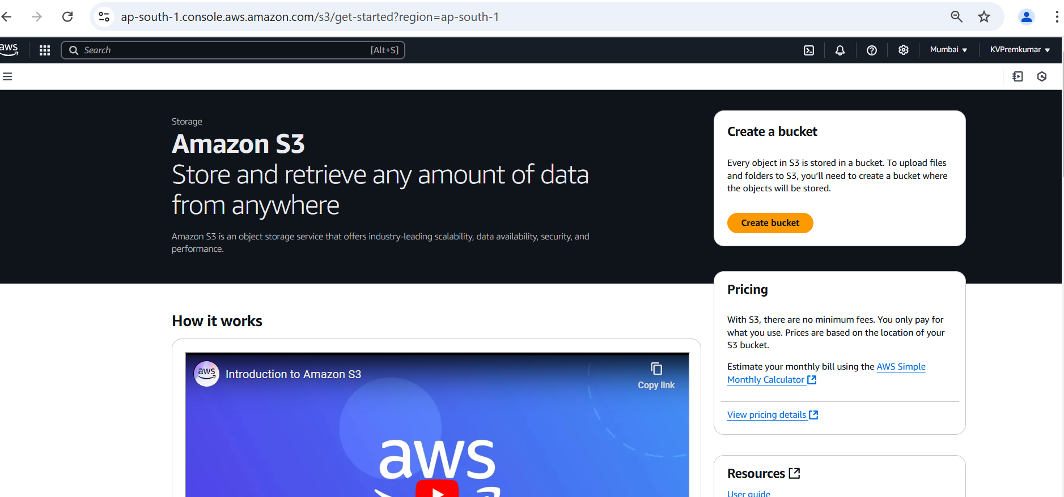
Go to S3 Console.
Click on Create Bucket.

Slide 6
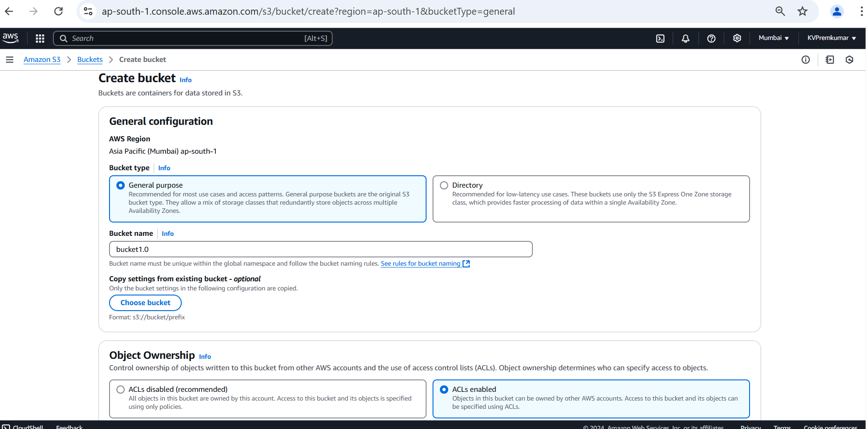
In General configuration select the bucket type as General Purpose.
Give the unique name to the bucket.
Enable the ACLs in Object Ownership.

Slide 7
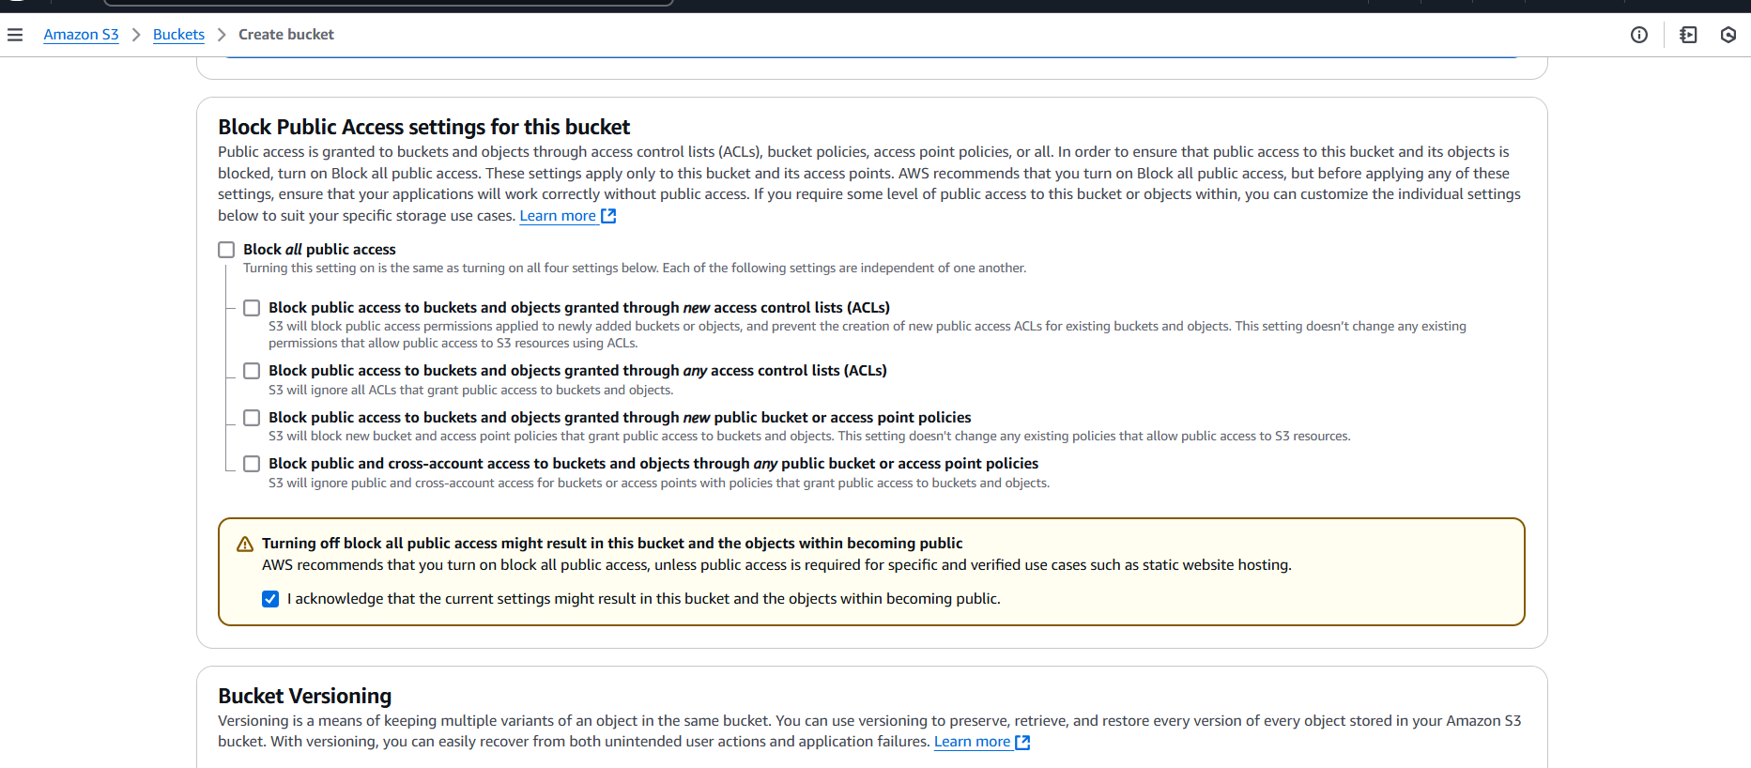
Deselect the Block all public access.
Select the Acknowledge option to off the block all public access.

Slide 8
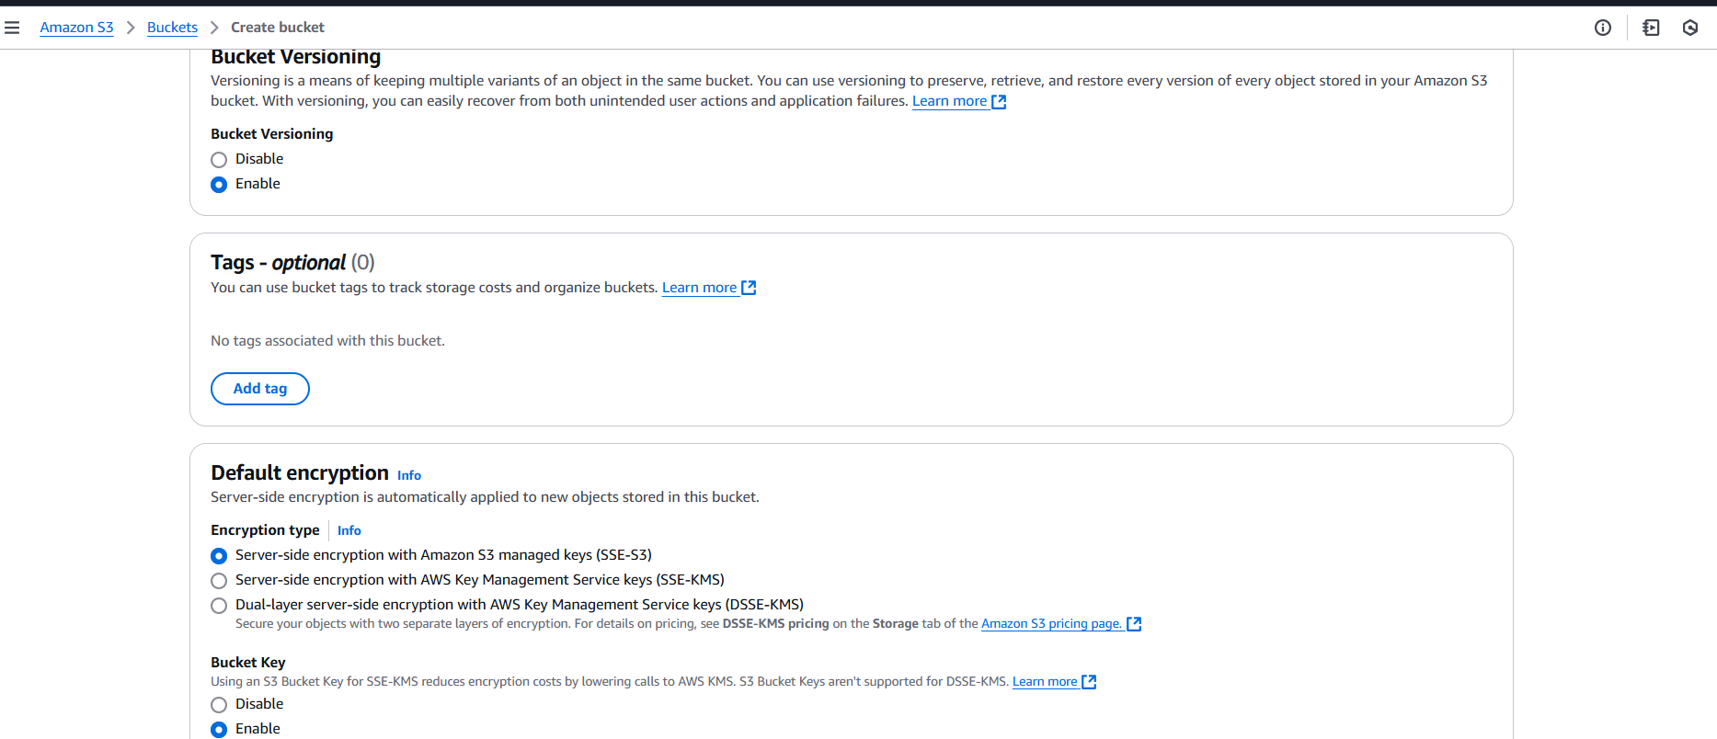
Enable the Bucket Versioning.
Keep the remaining all in default and Click on Create Bucket.

Slide 9
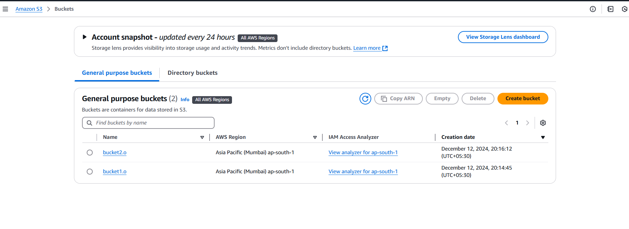
Create another bucket by doing the same process.
Here we can see the bucket creation.
Click on anyone of the bucket to open.

Slide 10
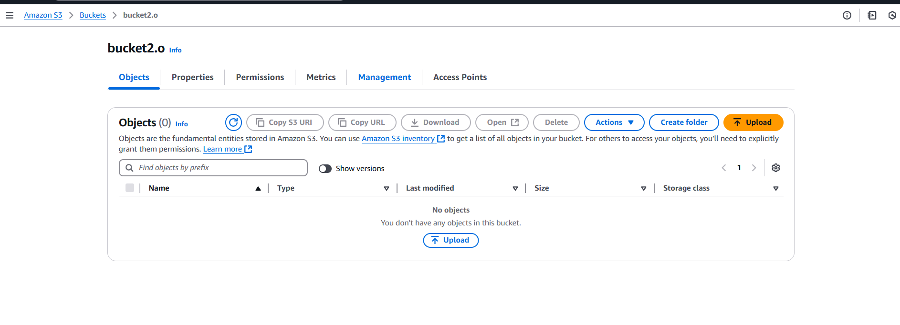
After opening the bucket, click on Management.

Slide 11
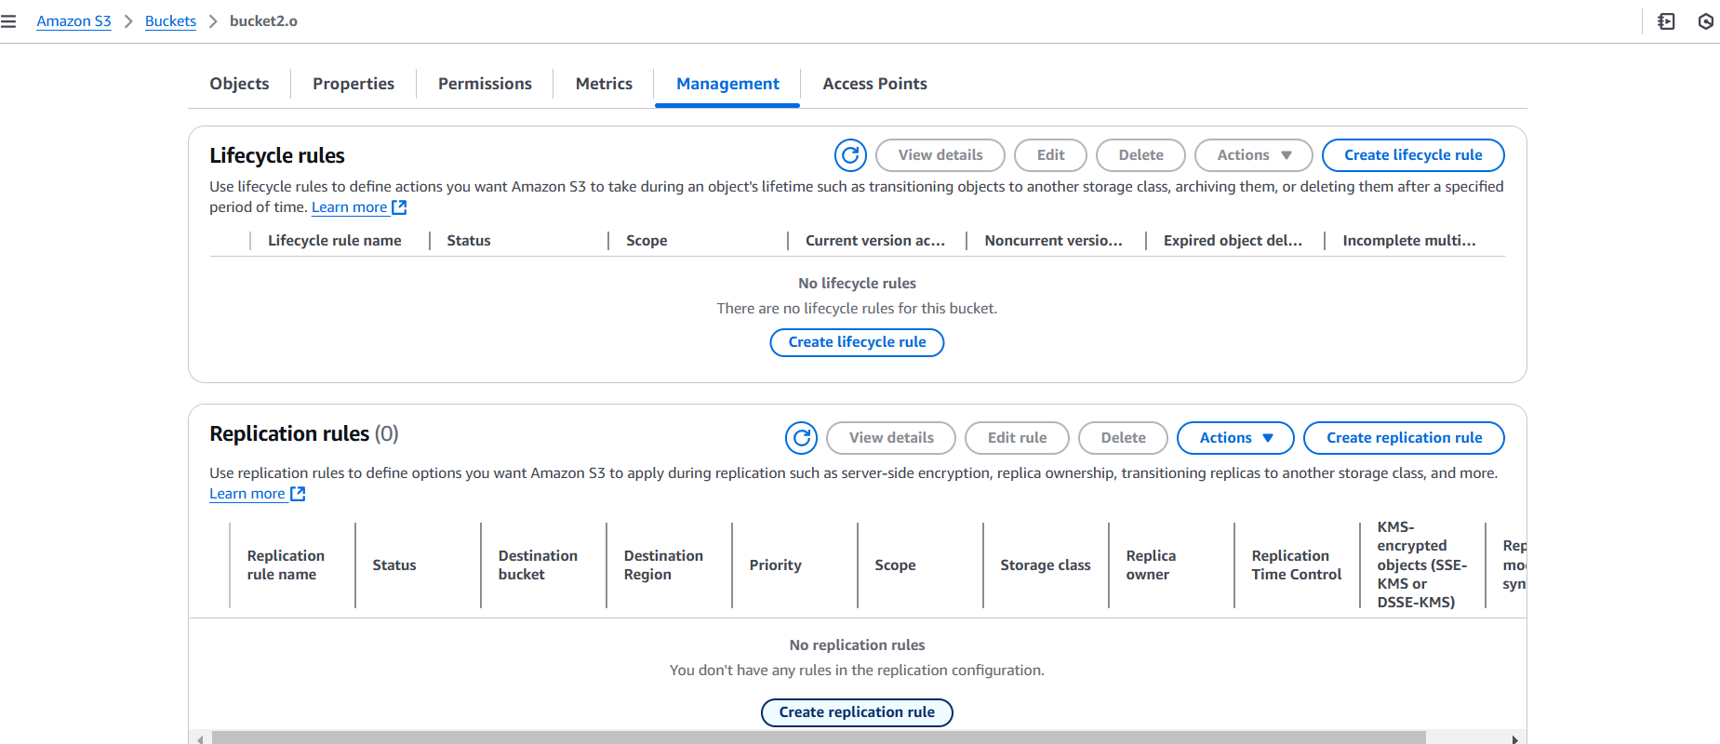
Go to Replication rule and click on Create replication rule.

Slide 12
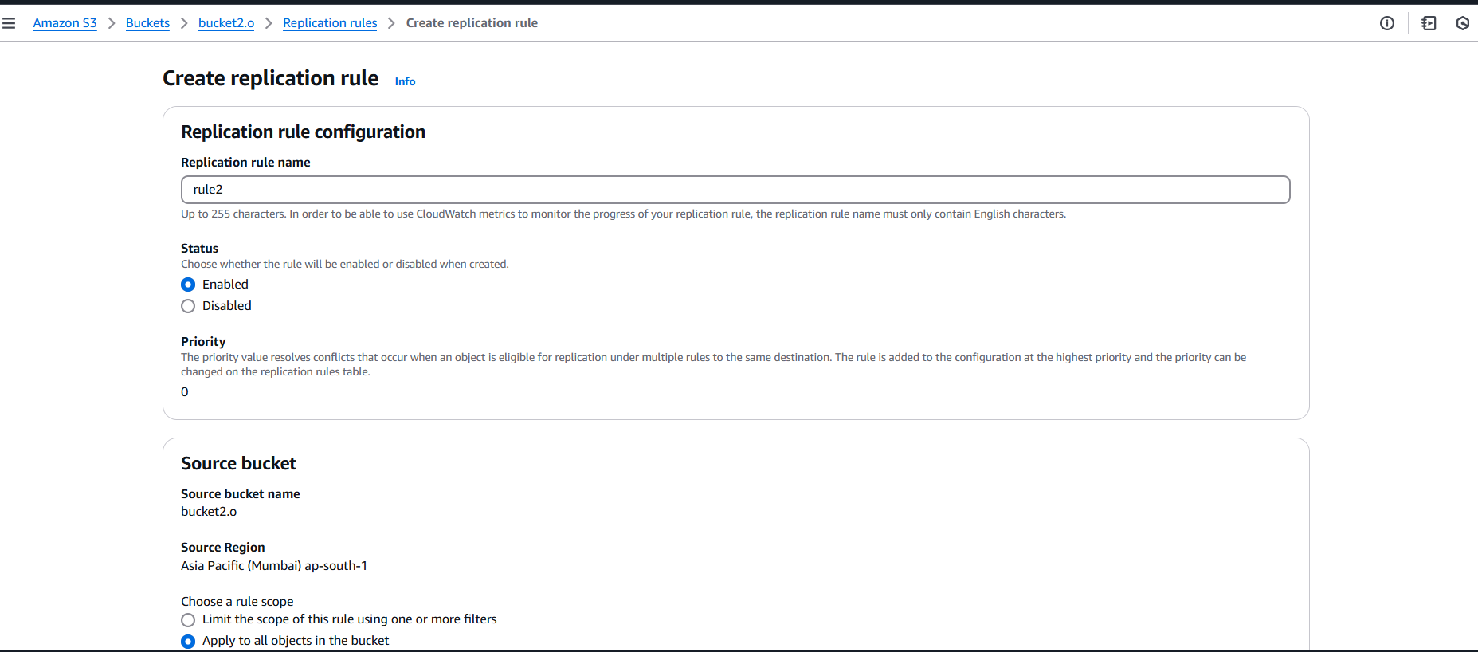
In the configuration give the name to the replication rule.
Enable the status.
In source bucket choose the rule scope as Apply to all object in the bucket.

Slide 13
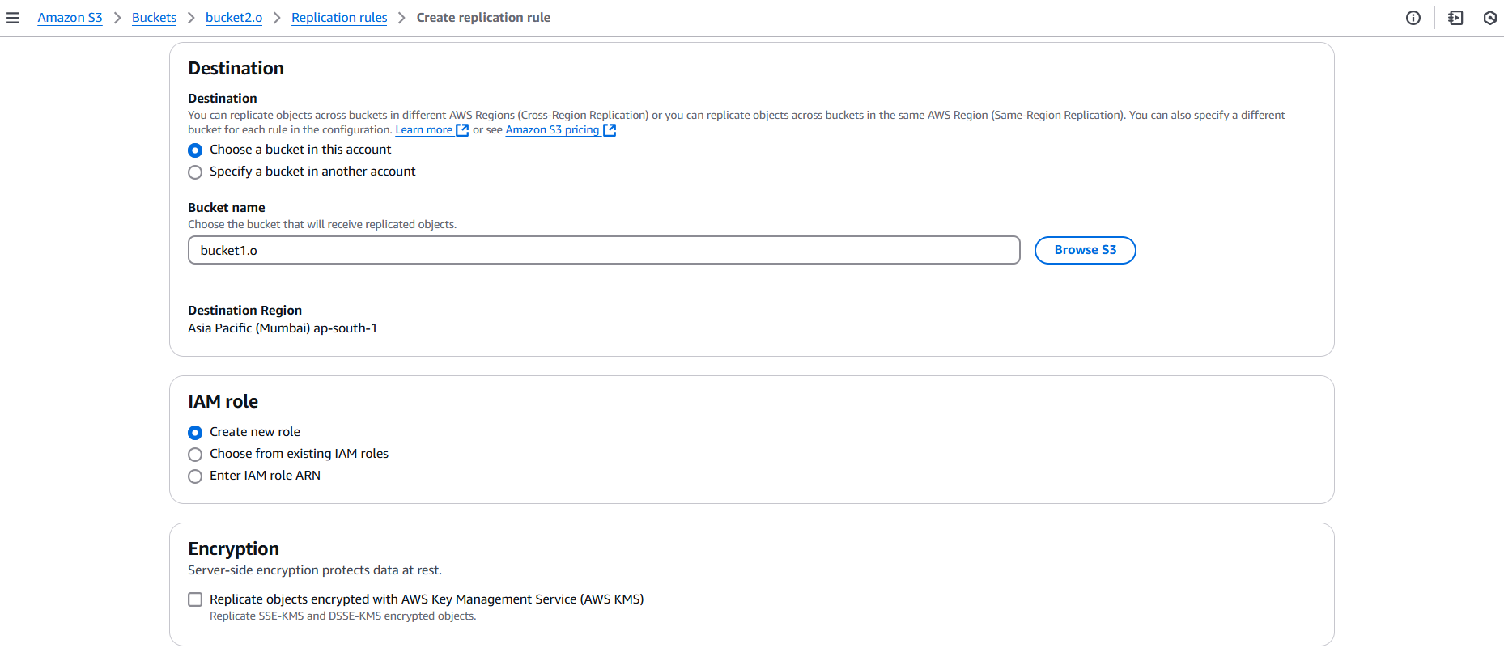
In the Destination choose another bucket where the object has to be replicate.
In IAM role select the option Create new role.

Slide 14
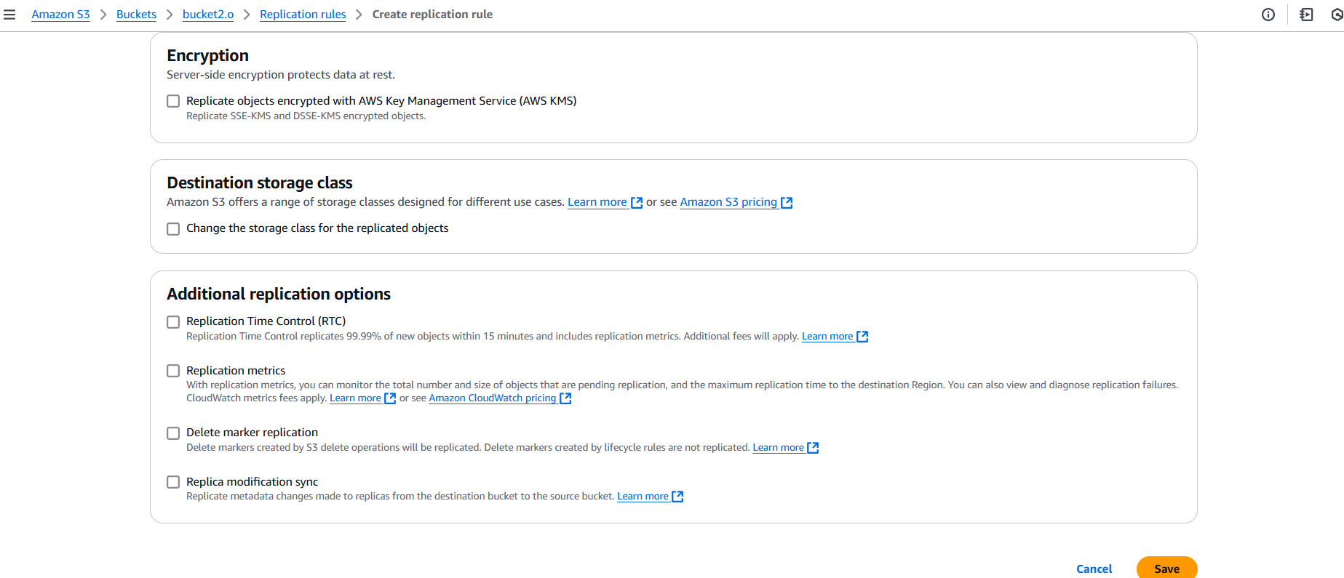
Keep the remaining all in default and Click on Save.

Slide 15
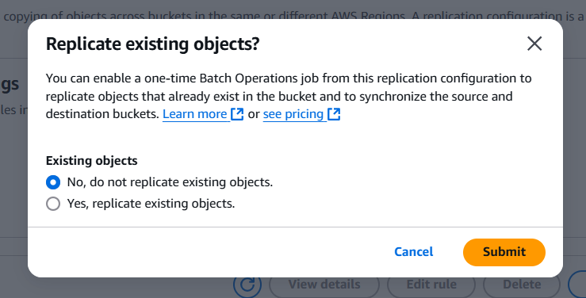
We can choose replication existing objects as per we need them.
Click on submit.

Slide 16
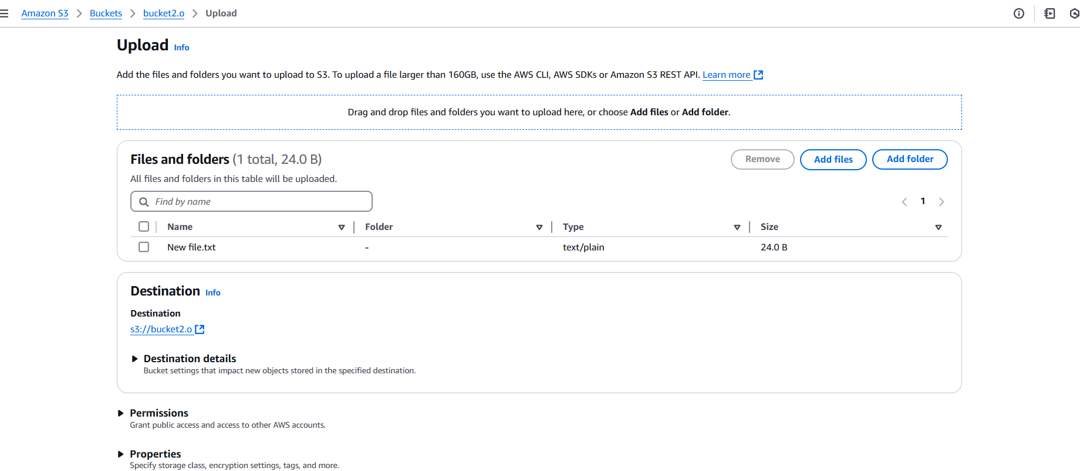
Go back to the bucket and click on Upload.
In Upload select Add File and select the file.

Slide 17
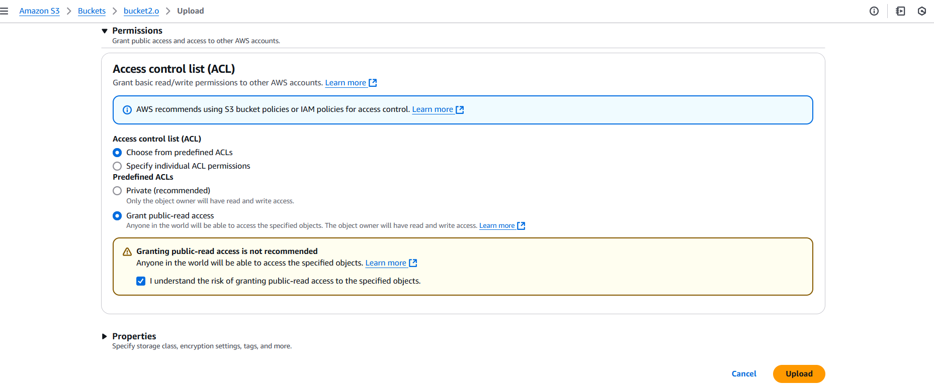
If you scroll down we will see the permissions.
We can select the Grant public-read access to make data visible in the object (optional) and after click on upload.

Slide 18
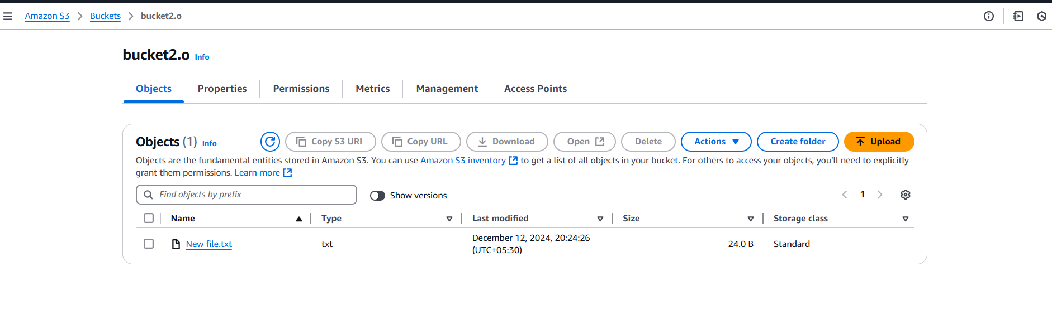
Here we can see the file is uploaded in first bucket.

Slide 19
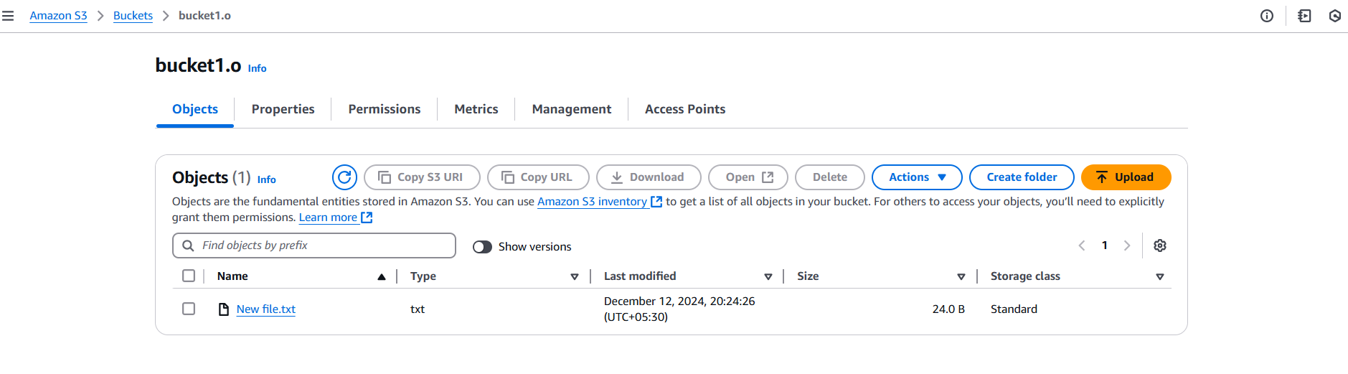
Go back and open the second bucket and check it.
Here the same file is replicated in the second bucket automatically.
We can also replicate the file from second bucket to first bucket to make the data copy in another region.

Slide 20
Thankyou

